Slide 1
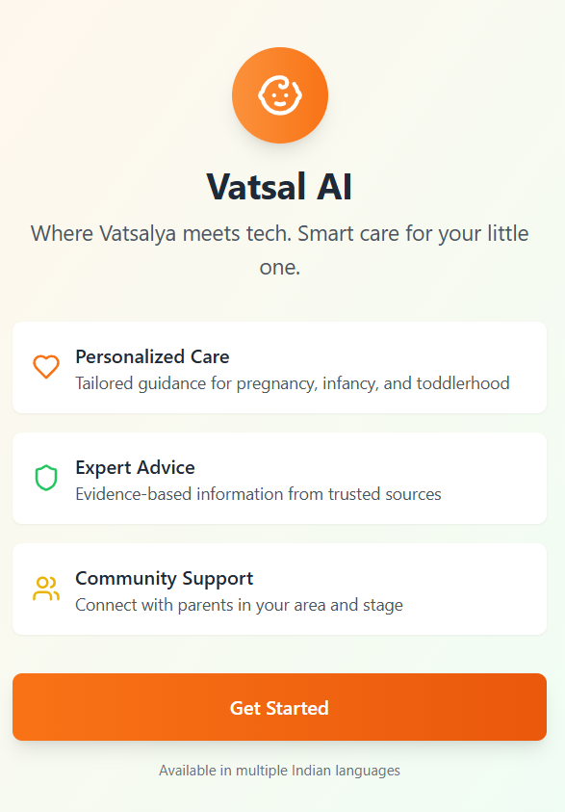
Precision Care Challenge 2025
Phase 1 – Idea Submission
Team - Vatsalya
Theme – Artificial Intelligence | child - Baby Care For Indian Parents
Demo video - Link
Prototype - Link
Git repo - Link
Preliminary results live test - Link
Team Details:
Vishal A S - AI developer linkedIn
Nandini Kuppala - Web and App developer linkedIn

Slide 2
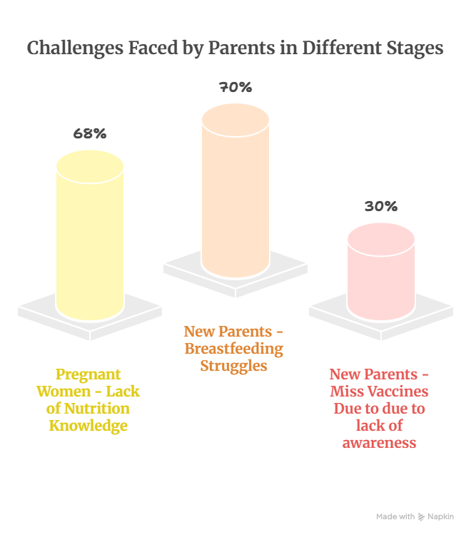
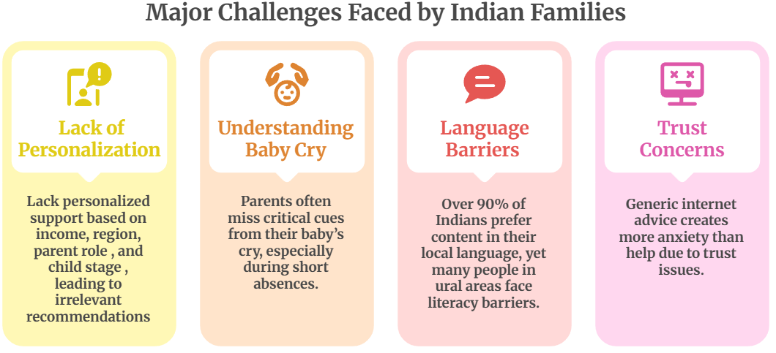
Problem Statement
The first 1000 days (from conception to age 2) determine 90% of a child's brain development, yet Indian families face critical challenges: Alarming statistic in India
Infant Mortality Rate: 25.8 deaths per 1,000 live births (2024)
Child Malnutrition: Over one-third of young children in India suffer from long-term malnutrition in India
Stunting Prevalence: 36% of children under 5 are stunted (NFHS-5, 2019-2021)
Maternal Loneliness: Over 26% of mothers in nuclear families in India report severe loneliness (ScienceDirect, 2024)

Slide 3
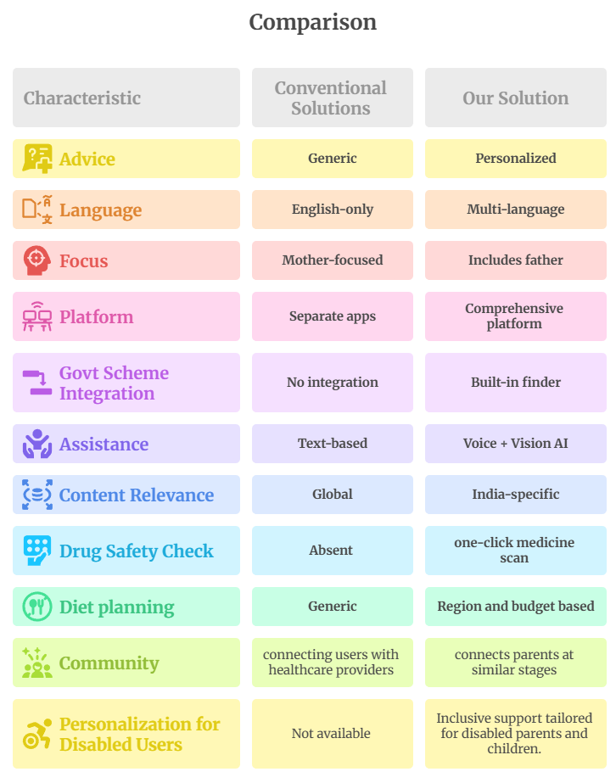
Solution - Vatsal AI
An AI-powered healthcare app that provides personalized, culturally-relevant, and actionable guidance for Indian parents.
Key Features Overview:
Smart Home Dashboard Personalized by Stage- Pregnancy, Infancy (0-12 months) and Toddlerhood (13-24 months).
AI Report Analysis with comparative assessment with previous reports during pregnancy and provide personalized recommendations and also check medicine compatibility.
AI Assistant with Multilingual support (10 indian languages) with voice ,video and image support.
Knowledge hub for mothers and Fathers for smart parenting and to make them aware of govt schemes etc.
Location based groups - connect with nearby mothers, find specialists in your locality, nearby playgrounds and parks.

Slide 4
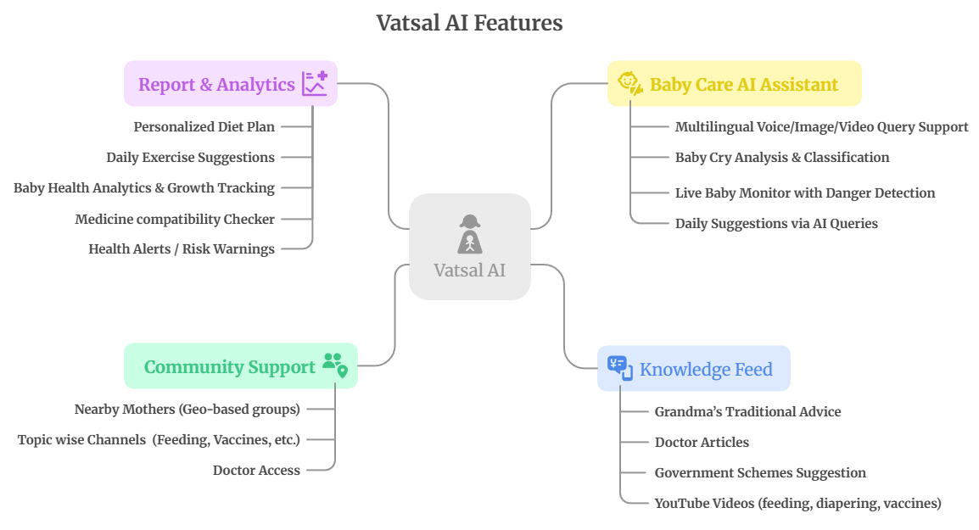

Slide 5

Unique Value Propositions
Tech stack
Live baby cry analysis: with real-time soothing suggestions.
Income-Based Personalization and disability inclusion : Different recommendations for families earning <₹2L, ₹2-8L, >₹8L with consideration of disability.
Regional Government Schemes Integration: Automatic discovery of state-specific benefits and community-based support to reduce maternal isolation.
AI-Powered Safety: Real-time baby monitoring with danger detection using computer vision and also clears doubts and confusions using images and voice.
Semantic search delivers instant, stage-specific health, diet and lifestyle information personalized for Pregnancy, Infancy, and Toddlerhood.
Drug Safety Check - Allows users to click a picture of a tablet sheet or pill box to instantly check if the medication is safe for babies or pregnant women.

Slide 6
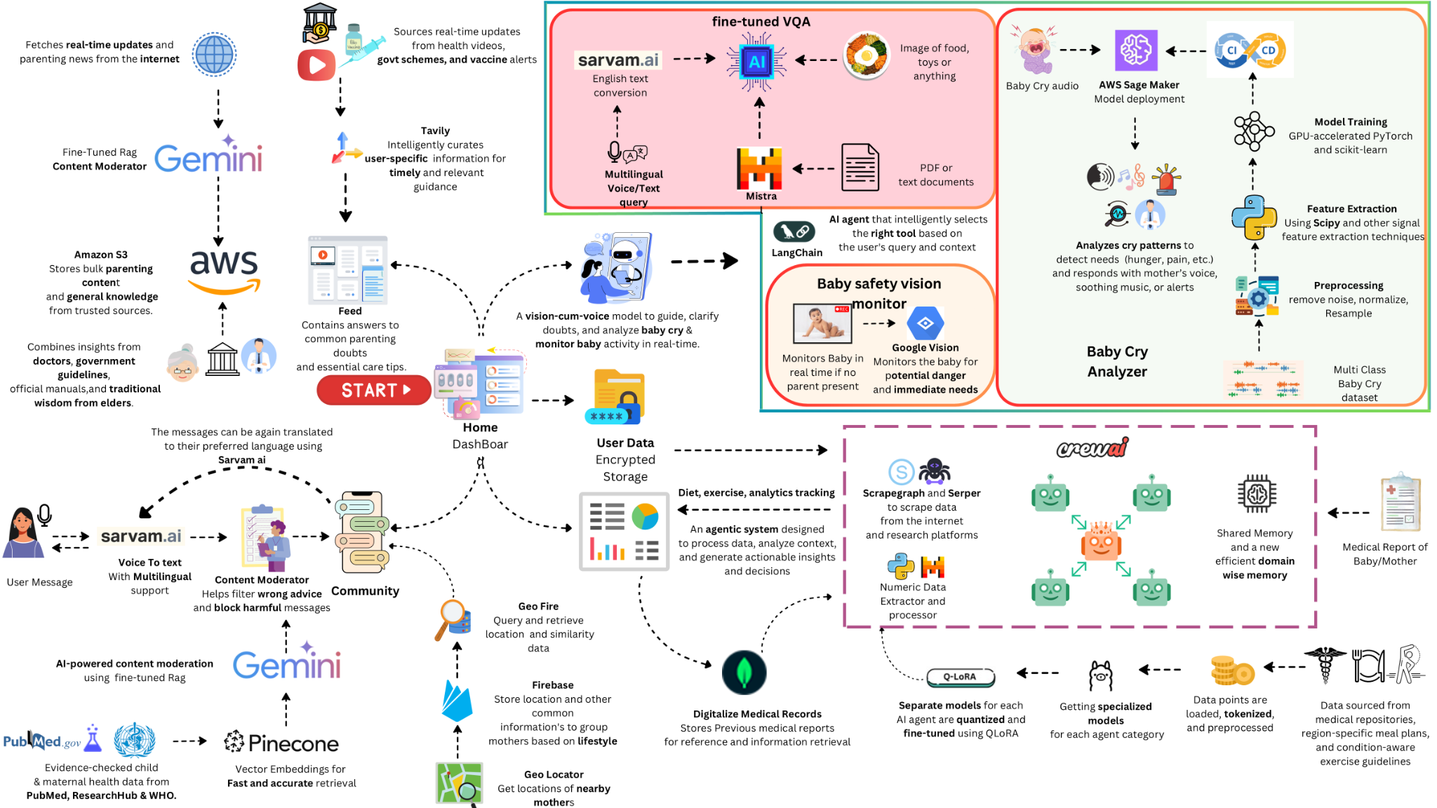
Artitecture

Slide 7
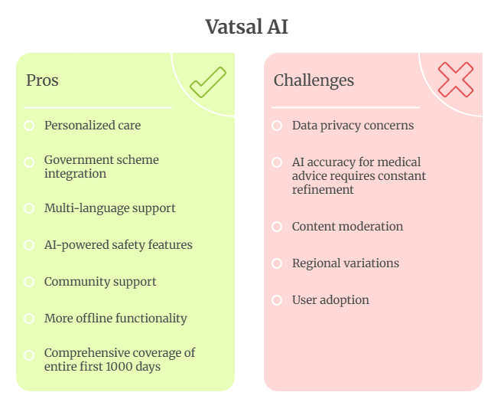
Pros and Cons of the Solution
Mitigation Strategies:
End-to-end encryption for all health data
Offline mode for essential features
Medical professional oversight for AI recommendations
Multi-tier content moderation system for community posts.
Partnerships with local healthcare providers
Simple, intuitive UI with multilingual voice-first interaction

Slide 8
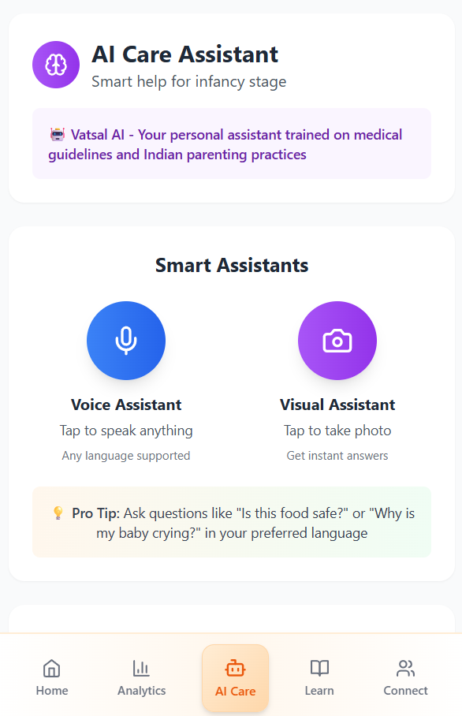
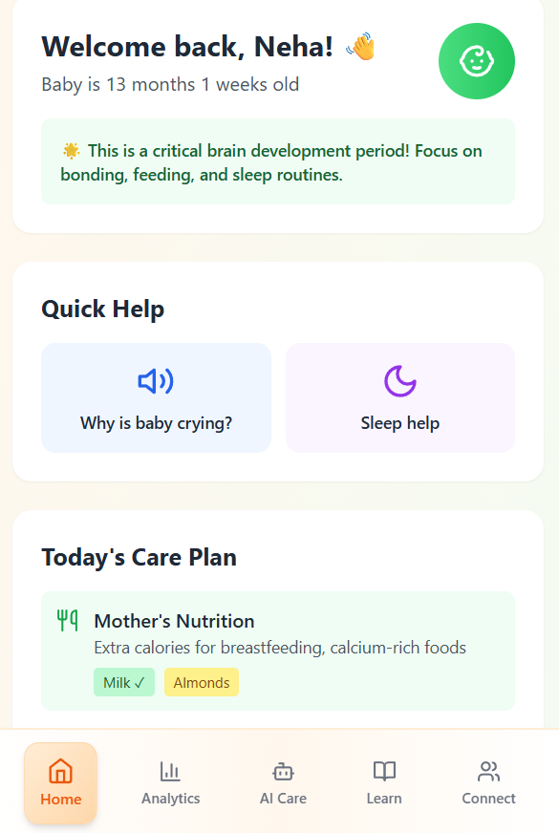
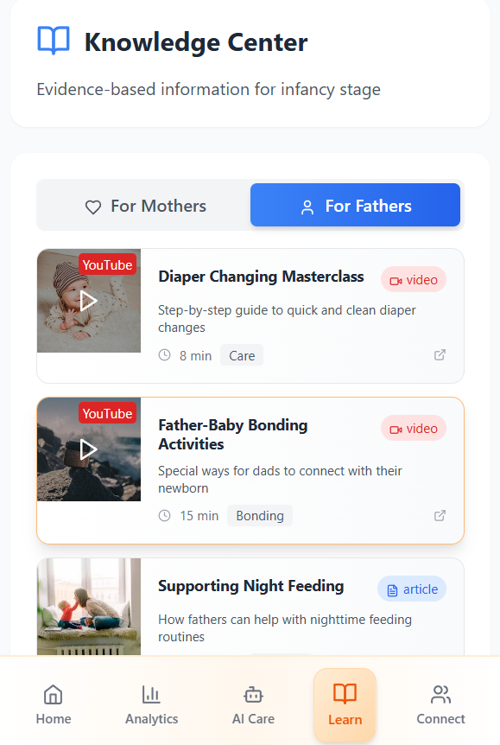
Snapshots of Prototype

Slide 9
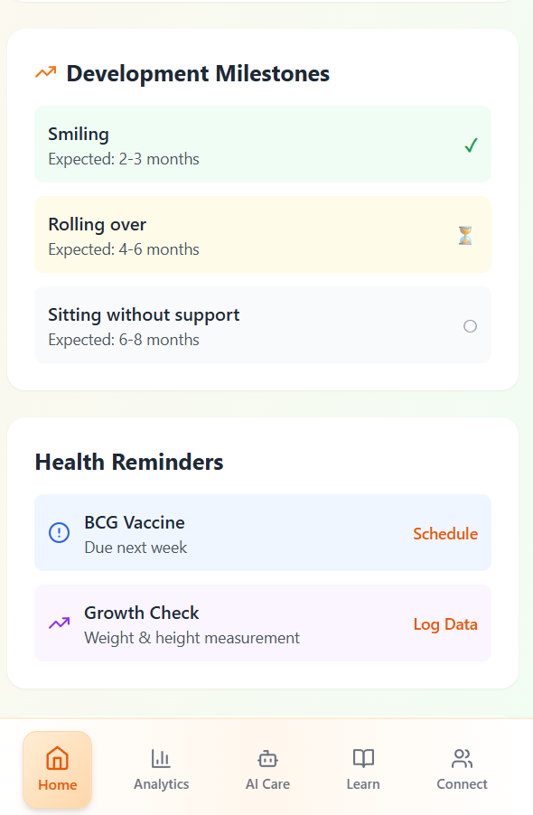
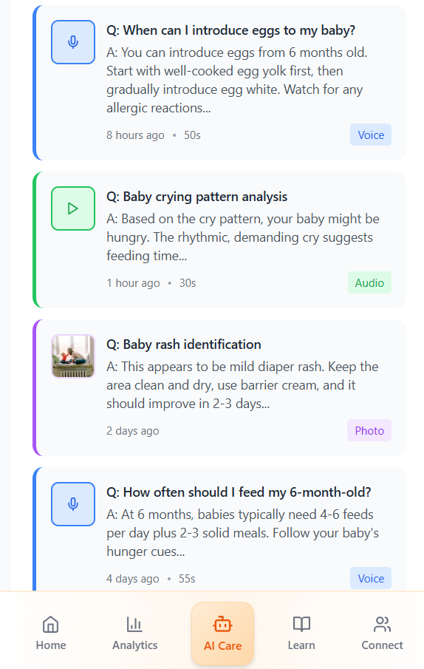
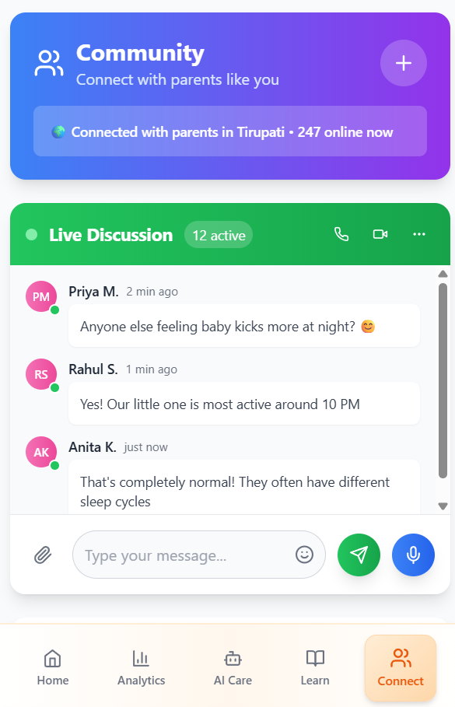
Snapshots of Prototype

Slide 10
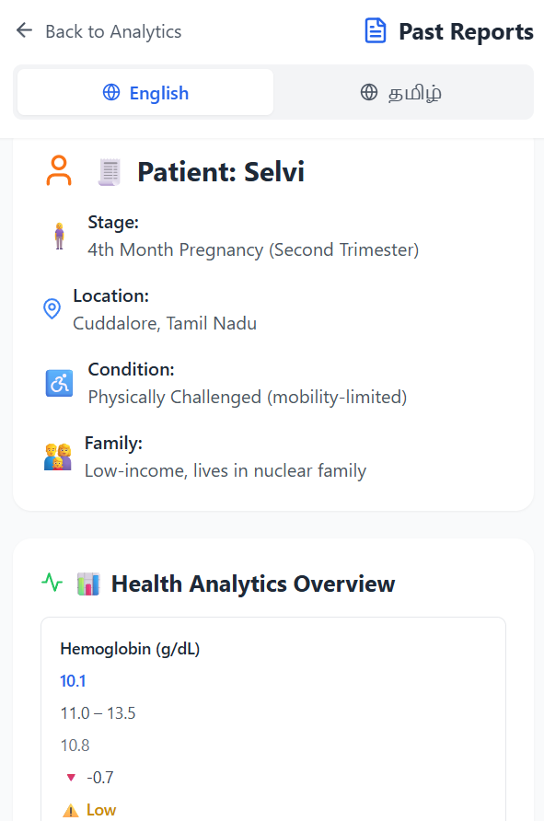
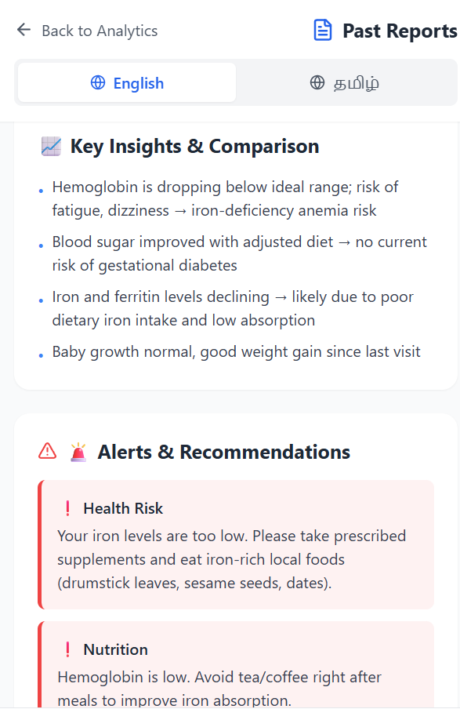
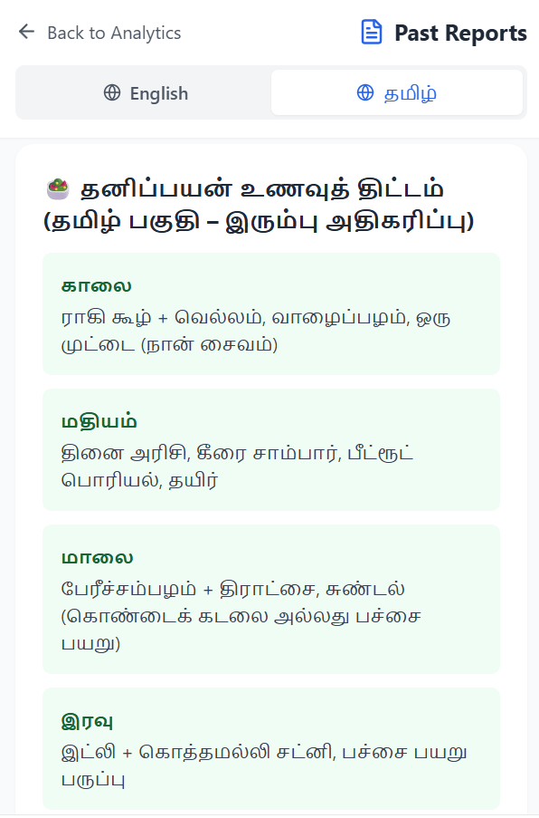
Preliminary Results - Report Analysis of a Patient (multilingual)

Slide 11
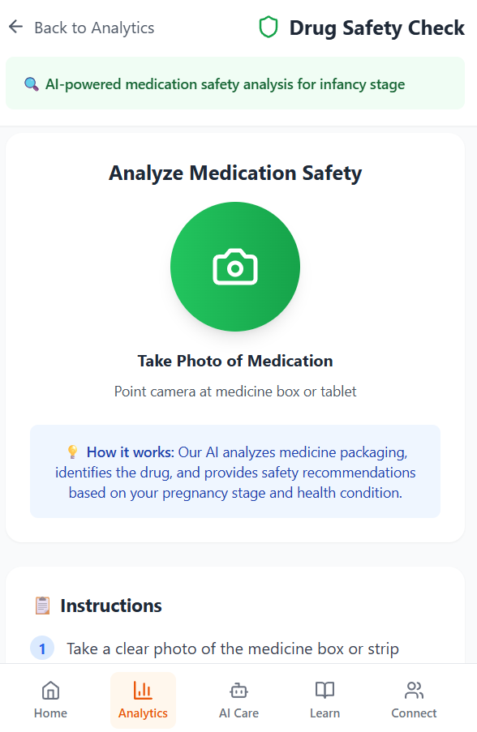
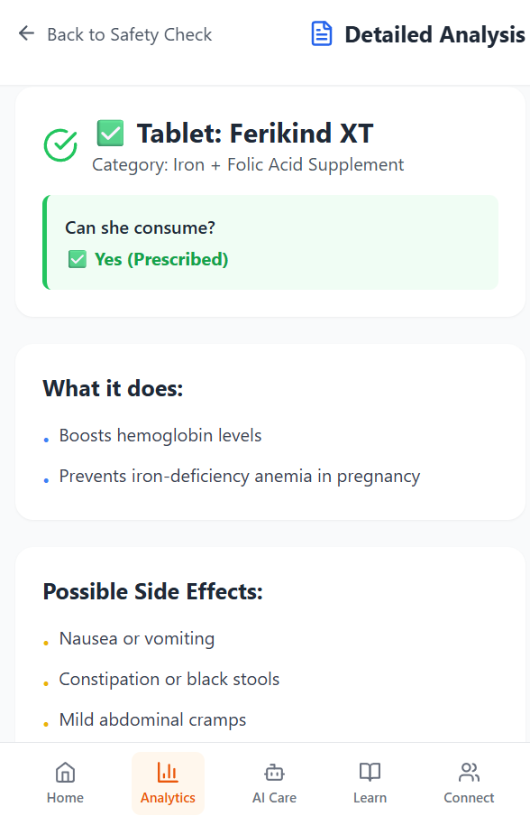
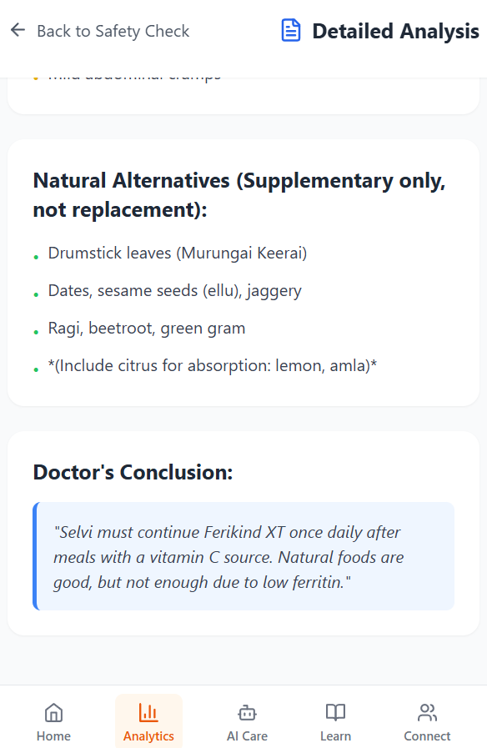
Preliminary Results - Drug Safety Check of a Patient

Slide 12
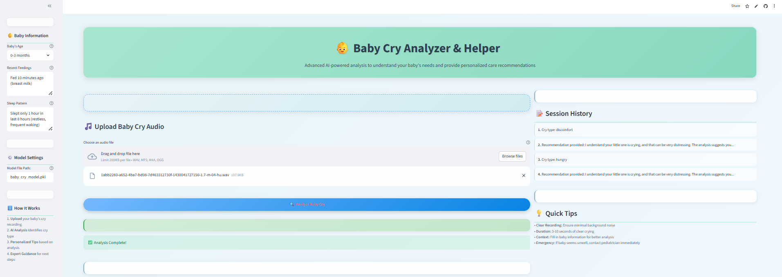
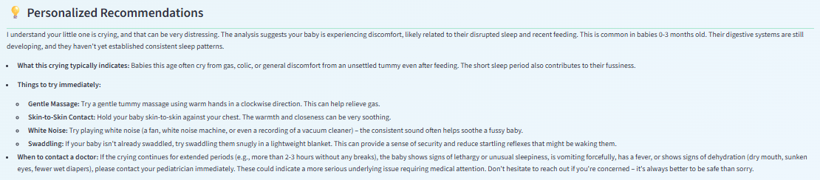
Preliminary Results - Sample Baby Cry Analysis
Outperforms existing research with a top accuracy of 98.7% and efficiency of 1.2ms per sample.

Slide 13
References
Official Government Statistics:
Press Information Bureau, Government of India (2023). https://www.pib.gov.in/PressReleasePage.aspx?PRID=1861710
MacroTrends (2024).https://www.macrotrends.net/global-metrics/countries/IND/india/infant-mortality-rate
Press Information Bureau, Government of India (2024). https://www.pib.gov.in/PressReleaseIframePage.aspx?PRID=2128024
World Bank Data (2024).https://data.worldbank.org/indicator/SP.DYN.IMRT.IN?locations=IN
Malnutrition & Child Health Research:
Goswami, I., et al. (2024) https://www.sciencedirect.com/science/article/pii/S2213398423002373
Observer Research Foundation (2021). https://www.orfonline.org/research/what-nfhs-5-data-shows
Press Information Bureau, Government of India https://www.pib.gov.in/PressReleasePage.aspx?PRID=1806601
National Centre for Biotechnology Information (2024). https://pmc.ncbi.nlm.nih.gov/articles/PMC11009545/
National Health Survey Reports:
DHS Program (2021). https://dhsprogram.com/pubs/pdf/FR375/FR375.pdf
Registrar General of India (2025).https://censusindia.gov.in/census.website/data/SRSMMB
National Health Mission (2024). Child Health. https://nhm.gov.in/index1.php?lang=1&level=2&sublinkid=819&lid=219
Academic Research:
Nature Scientific Reports (2023): https://www.nature.com/articles/s41598-023-37587-y
National Centre for Biotechnology Information (2024). https://pmc.ncbi.nlm.nih.gov/articles/PMC10991083/
ScienceDirect (2022). https://www.sciencedirect.com/science/article/pii/S2213398422002007
‹#›

